Slide 1
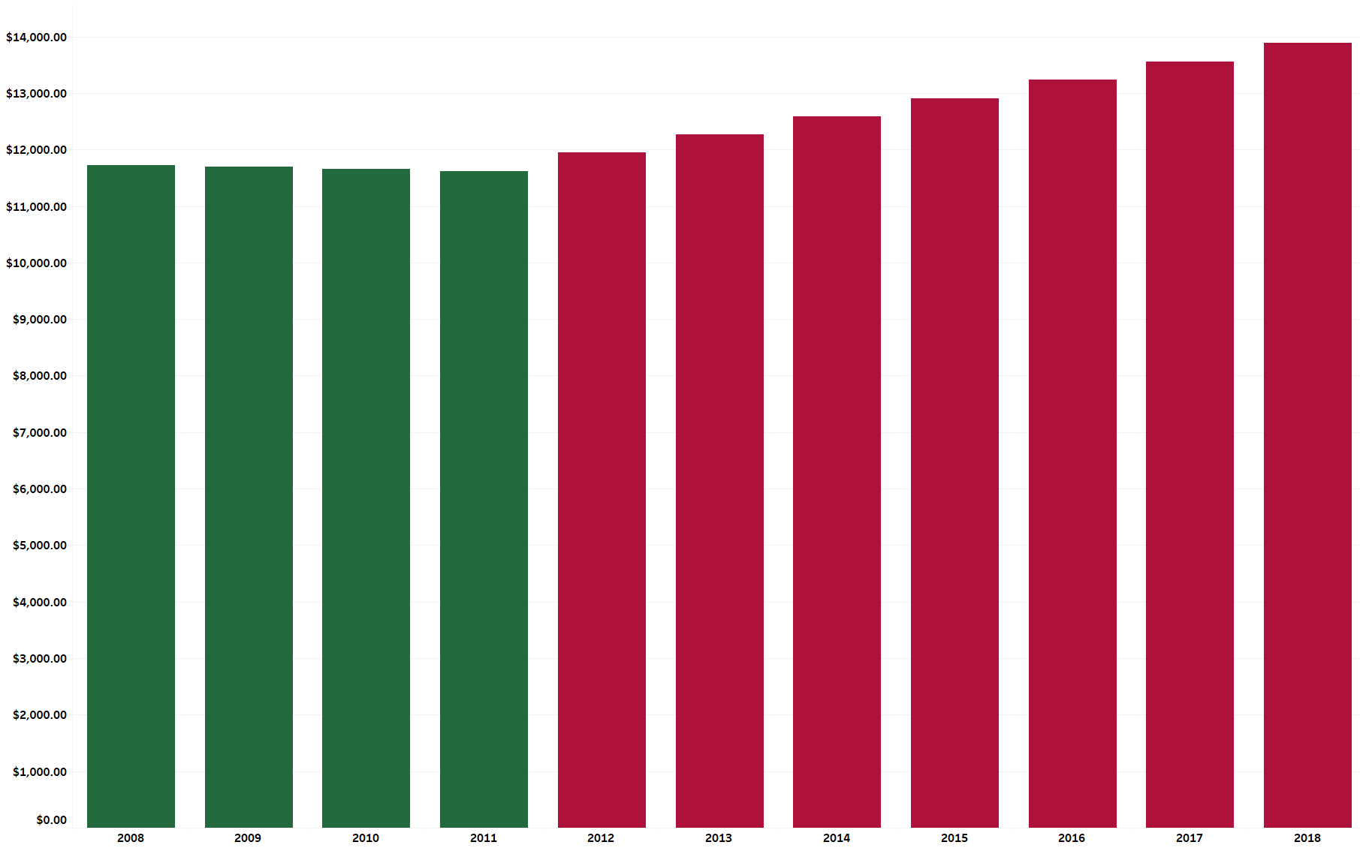
In 2008 Childcare costs averaged $11,700 per year.

Slide 2
In 2009 Childcare costs averaged $11,700 per year.

Slide 3
In 2010 Childcare costs averaged $11,600 per year.

Slide 4
In 2011 Childcare costs averaged $11,600 per year.

Slide 5
In 2012 Childcare costs averaged $11,900 per year.

Slide 6
In 2013 Childcare costs averaged $12,200 per year.

Slide 7
In 2014 Childcare costs averaged $12,600 per year.

Slide 8
In 2015 Childcare costs averaged $12,900 per year.

Slide 9
In 2016 Childcare costs averaged $13,200 per year.

Slide 10
In 2017 Childcare costs averaged $13,500 per year.

Slide 11
In 2018 Childcare costs averaged $13,800 per year.

